Slide 1
SIS Football Analytics Challenge
Entry for Zach Feldman, Michael Egle, and Anthony Reinhard

Slide 2
The Problem At Hand
SIS posed a series of questions regarding value of defensive line positions. Which one is the most valuable? What’s the talent distribution like? How can it change in different situations?
Data for players on the defensive line is both limited in its history and rarely made available to the public. The three of us were very excited to dive in and learn more about the potential impact different positions can make in different situations.

Slide 3
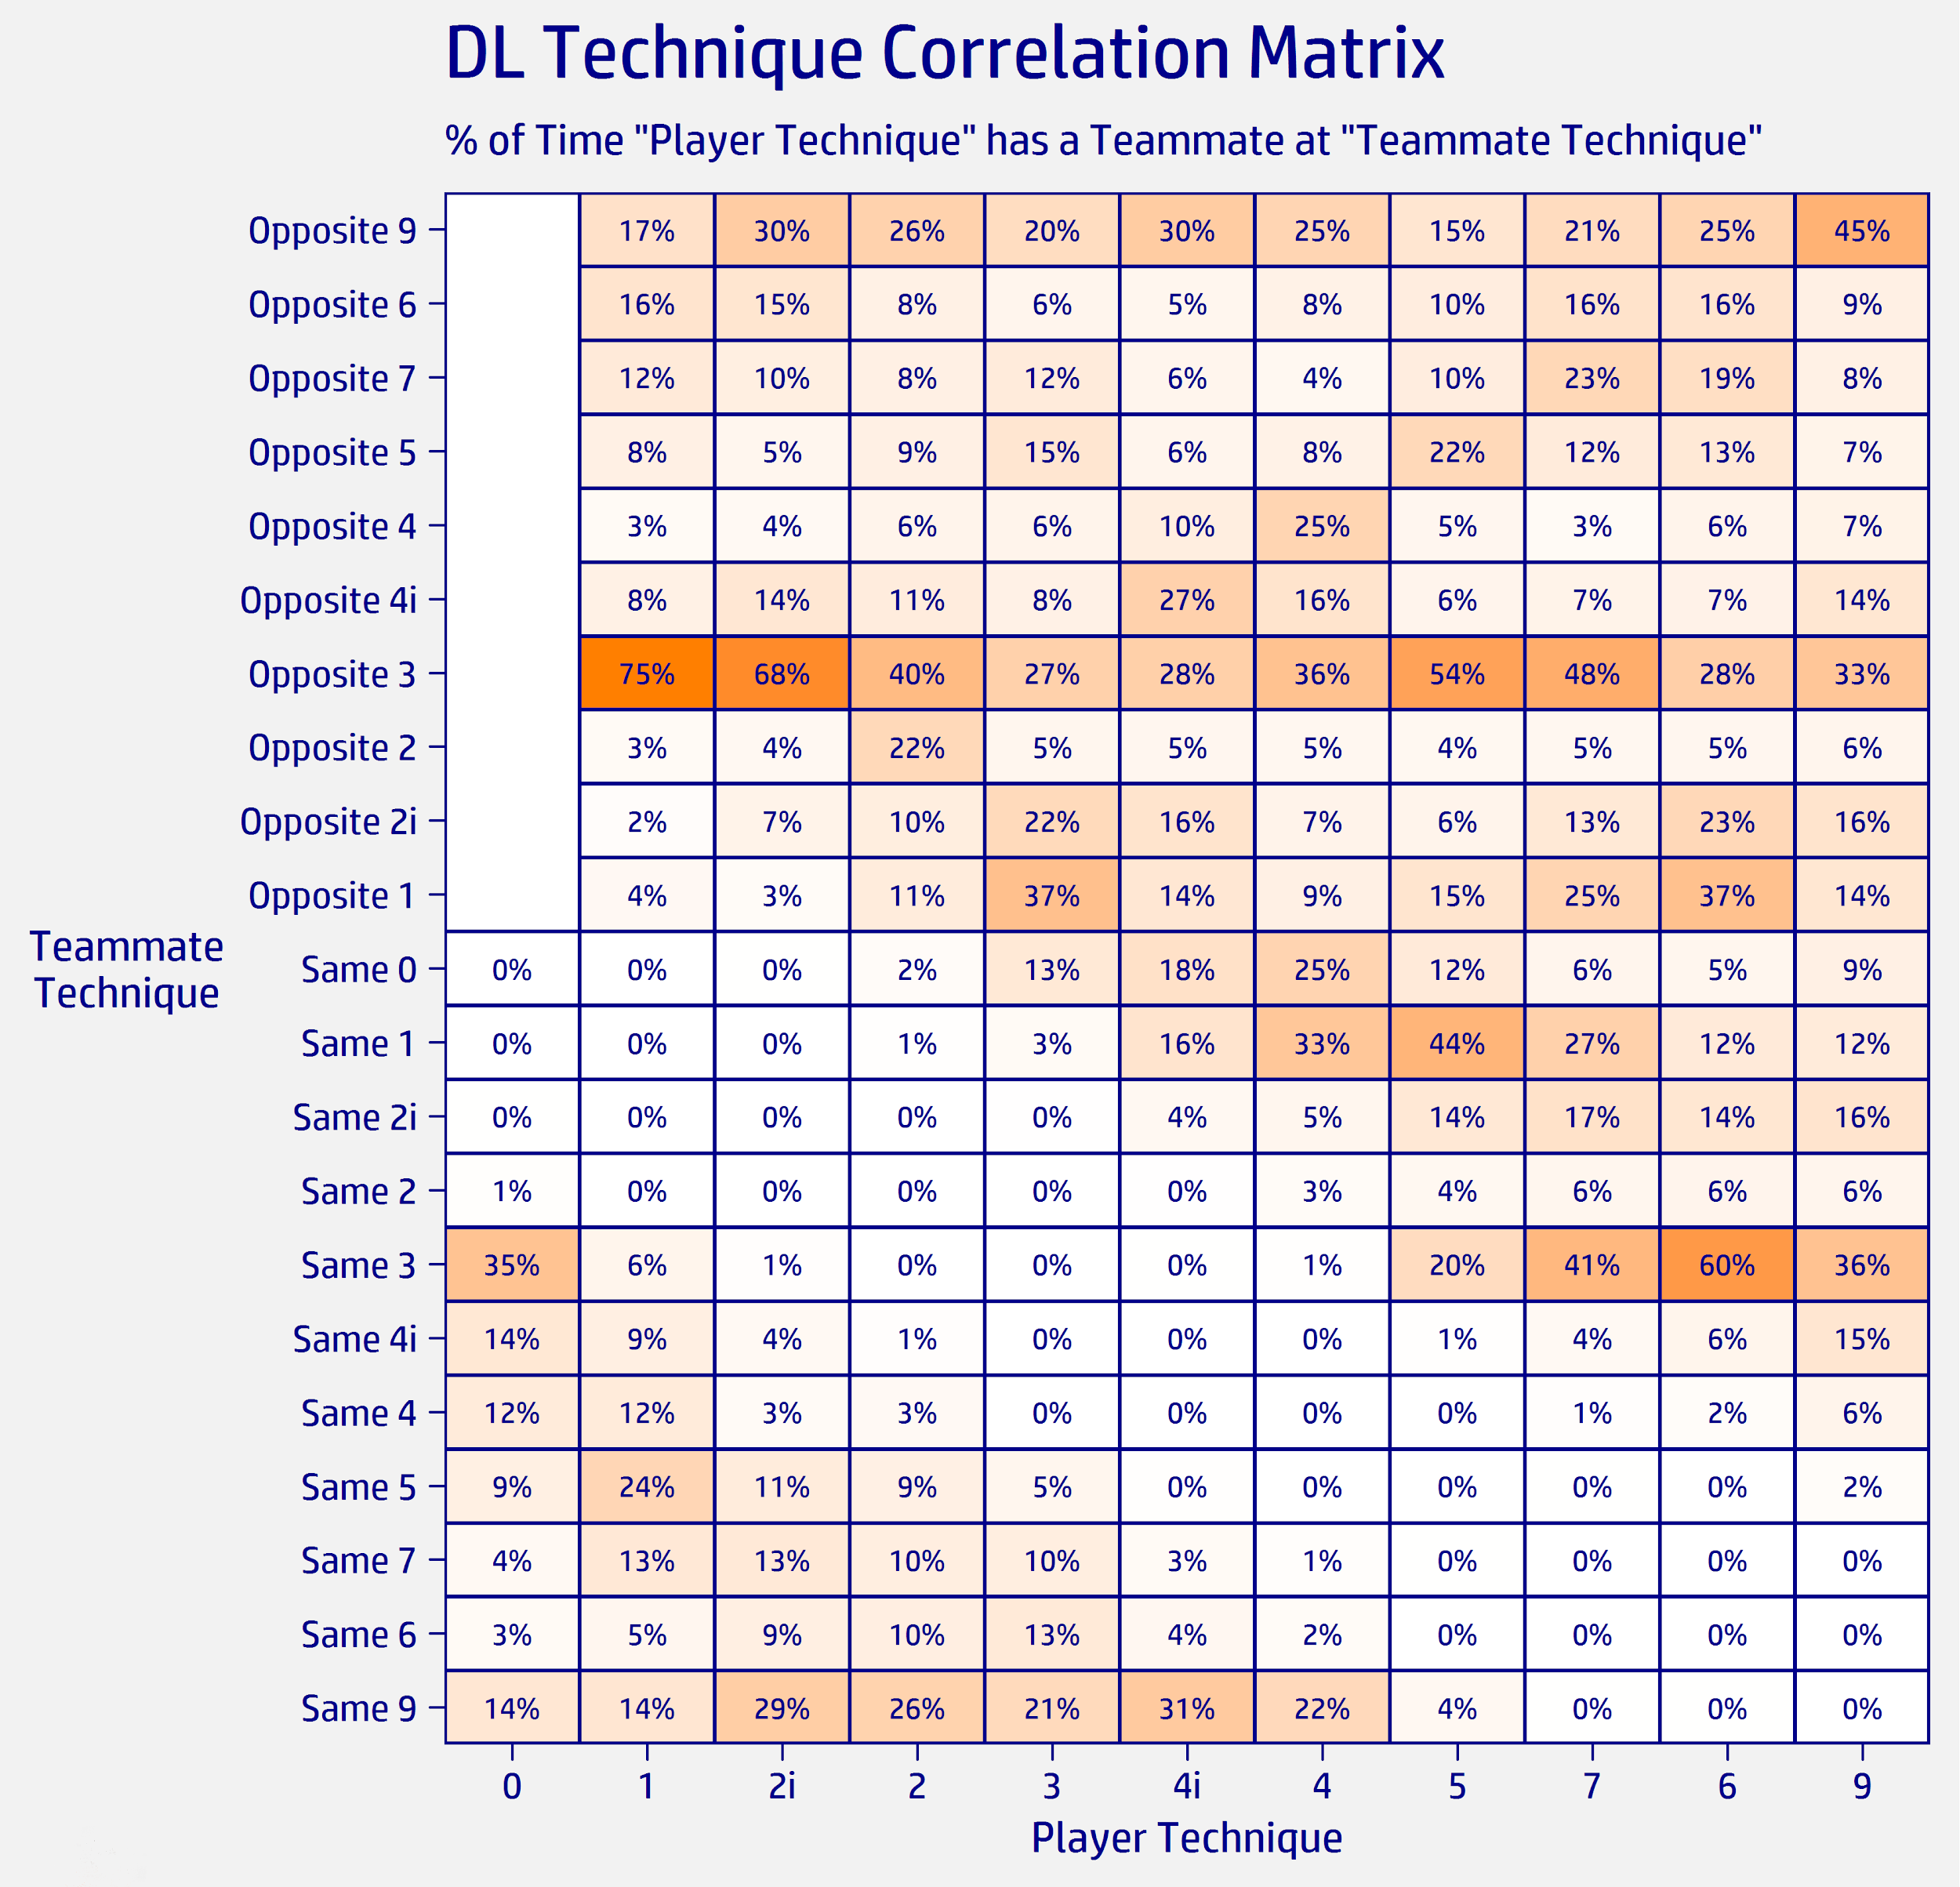
Defining the Positions
Our first goal was to better understand the responsibilities of the players based on technique and how we could group players together. We started with only down-linemen and made this matrix to help visualize what other techniques a player might be lined up on a play.

Slide 4
Positional Cutoffs
We ultimately decided on the following classification system:
EDGE - Player without a hand in the dirt (Technique Name = “Outside”)
NOSE - Player at the 0 or 1 technique that does not have a teammate inside a three technique on either side.
DT - Player inside a four technique who is not a NOSE
IDL - Any player with a hand in the dirt who does not meet the previous criteria

Slide 5
The Most Valuable Positions - Prior
Now that we had established some positional groups, we thought about which of these positions are most valuable. Here are the rankings we settled on:
EDGE - Can affect the passing game as a pass rusher, but could also drop back into coverage
NOSE - This player takes up a lot of space usually as the middle defender in a 3-4 scheme.
IDL - Usually strong pass rushers, but may not provide as much support in the run game
DT - Not responsible for as much space and generally are
not as strong pass rushers

Slide 6
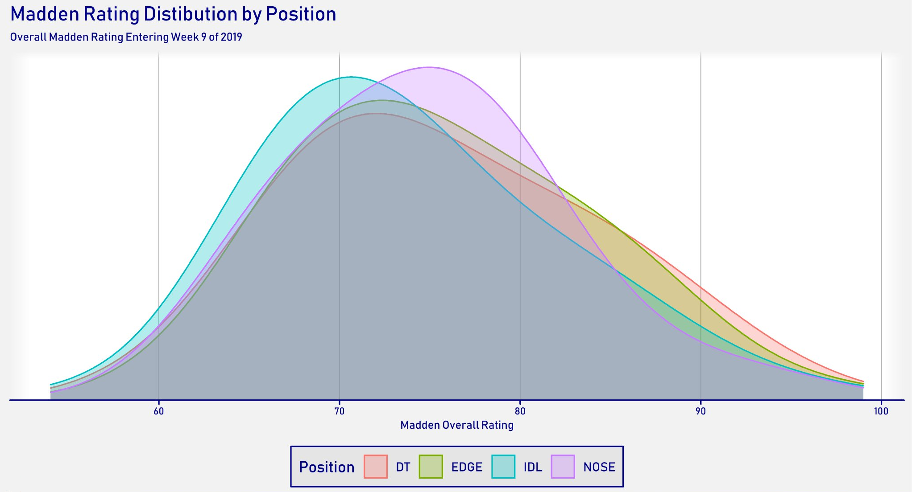
Talent Distribution - Prior
We thought it would be interesting to view the talent distribution in terms of Madden Ratings. The NOSE position is the most unique as it shows a high floor, but low ceiling. This tracks with our prior that these players need to be good enough to take up a lot of space, but aren’t necessarily the players who impact the game the most.

Slide 7
Situational Differences - Prior
While brainstorming how positions could gain or lose value based on specific situations we came up with rushing the passer and short yardage/goalline situations. Our belief is that EDGE and IDL will be better at rushing the passer and Nose will gain the most value in short yardage situations.

Slide 8
Models
Individual EPA Impact: Since not all players contribute the same to a given play, we wanted to quantify a player’s contribution. We used a generalized additive model to determine the impact a player has on a play’s EPA depending on what they contributed to the play. Two separate models were used for this:
Passing Model: includes pressure, sack, interception, forced/recovered fumble, pass breakups.
Rushing Model: includes unforced/forced/recovered fumble, solo/assisted tackle, whether the runner used the designed gap, and if the defender filled the gap the runner used.

Slide 9
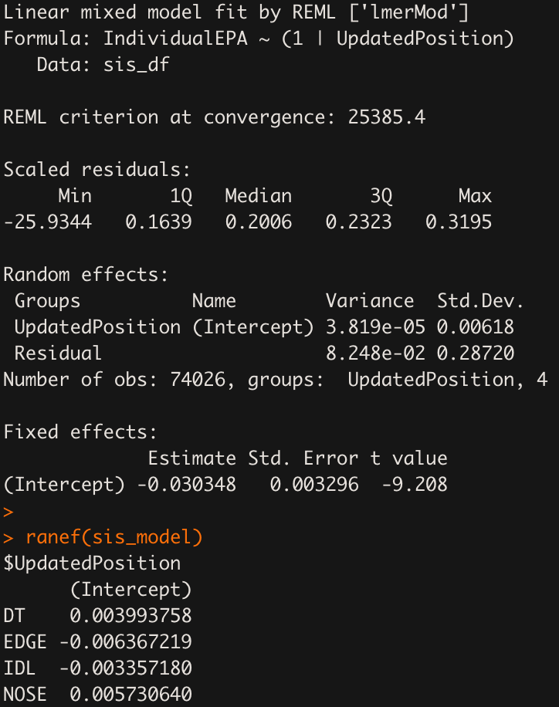
Models
Next we used a Mixed Effects Model to determine Individual EPA based on Position as a way to determine which is most valuable in terms of Individual EPA. The formula is simply IndividualEPA ~ (1|Position). To the right is the model’s results. As you can see, there are slight yet distinct variations among the positions.

Slide 10
Models
Generating Pressure: A generalized logistic mixed model to determine the factors most important for an individual player generating a pressure on a given pass play. The formula for the model is Pressure ~ IsRushing + pass_down + ovr_rating + (1|pos_grp), where
Pressure indicates if the player got a pressure
IsRushing indicates if the player was rushing the passer
pass_down indicates if the down and distance was a typical passing down
ovr_rating as the scaled madden rating for the player
(1|pos_grp) a random intercept for the position of the player

Slide 11
Model Reasoning
Getting sacks is the most valuable part of a pass play for the defense outside of turnovers, which are effectively random
It is widely accepted throughout the football analytics community that pressures are a better stat to look at than sacks due to the random nature of turning a pressure into a sack
This played out in our analysis after first creating a similar model for getting a Sack, but the model having very poor performance
The only variable that stuck out was if the player got a pressure on the play
That led us to modeling only for generating a pressure

Slide 12
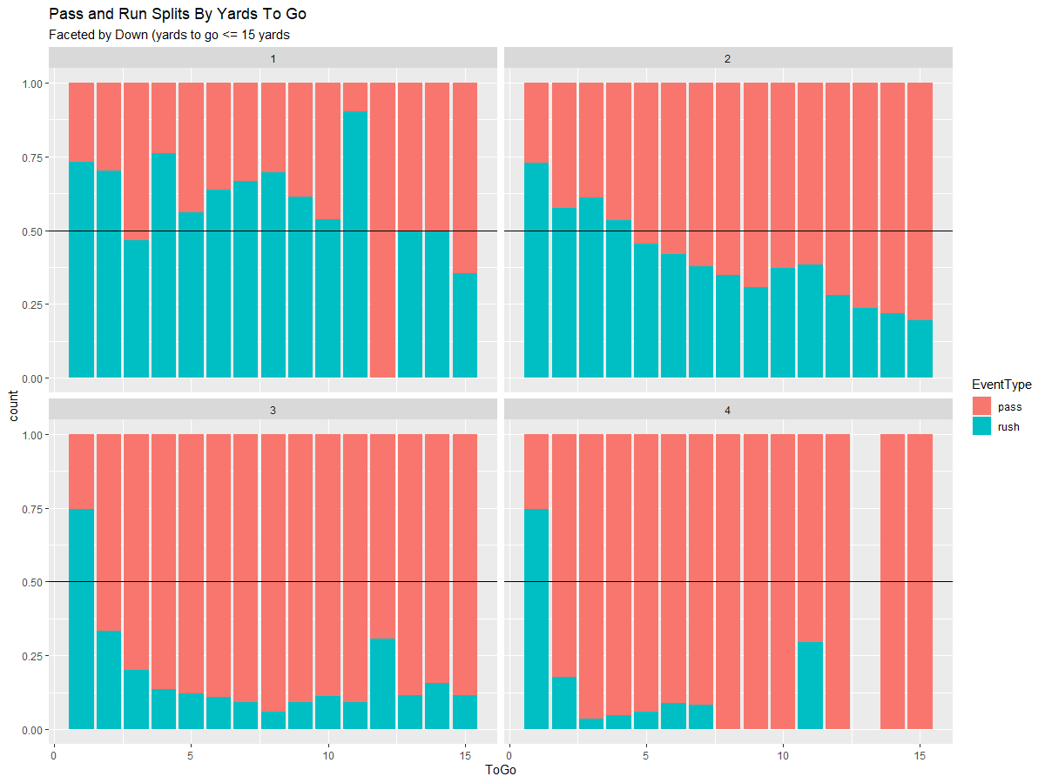
Definition of pass_down
We used the graphic on the left to determine our definition for what a typical passing down is.
We defined it as 2nd down with >= 5 yards to go or 3rd/4th down with >= 3 yards to go.
While 3rd/4th down could be considered at 2 yards to go, we felt defenses may still play the run more often than the frequencies show.

Slide 13
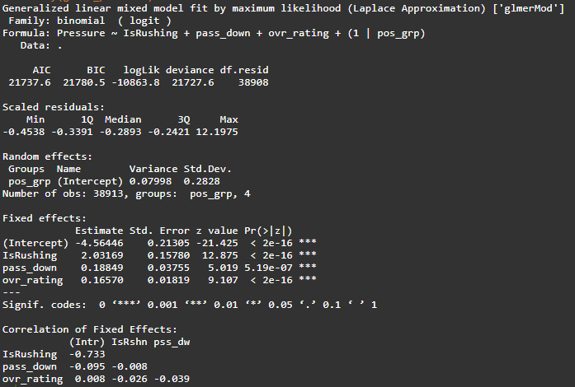
Model Summary
From our model output we can see that the most obvious impact to generating a pressure is actually rushing the passer with a change in log-odds of 2.03.
After that, whether or not it is a passing down and the Madden rating of the player are about equally important in determining if the player got a pressure on the play with changes in log-odds of 0.19 and 0.17 respectively.

Slide 14
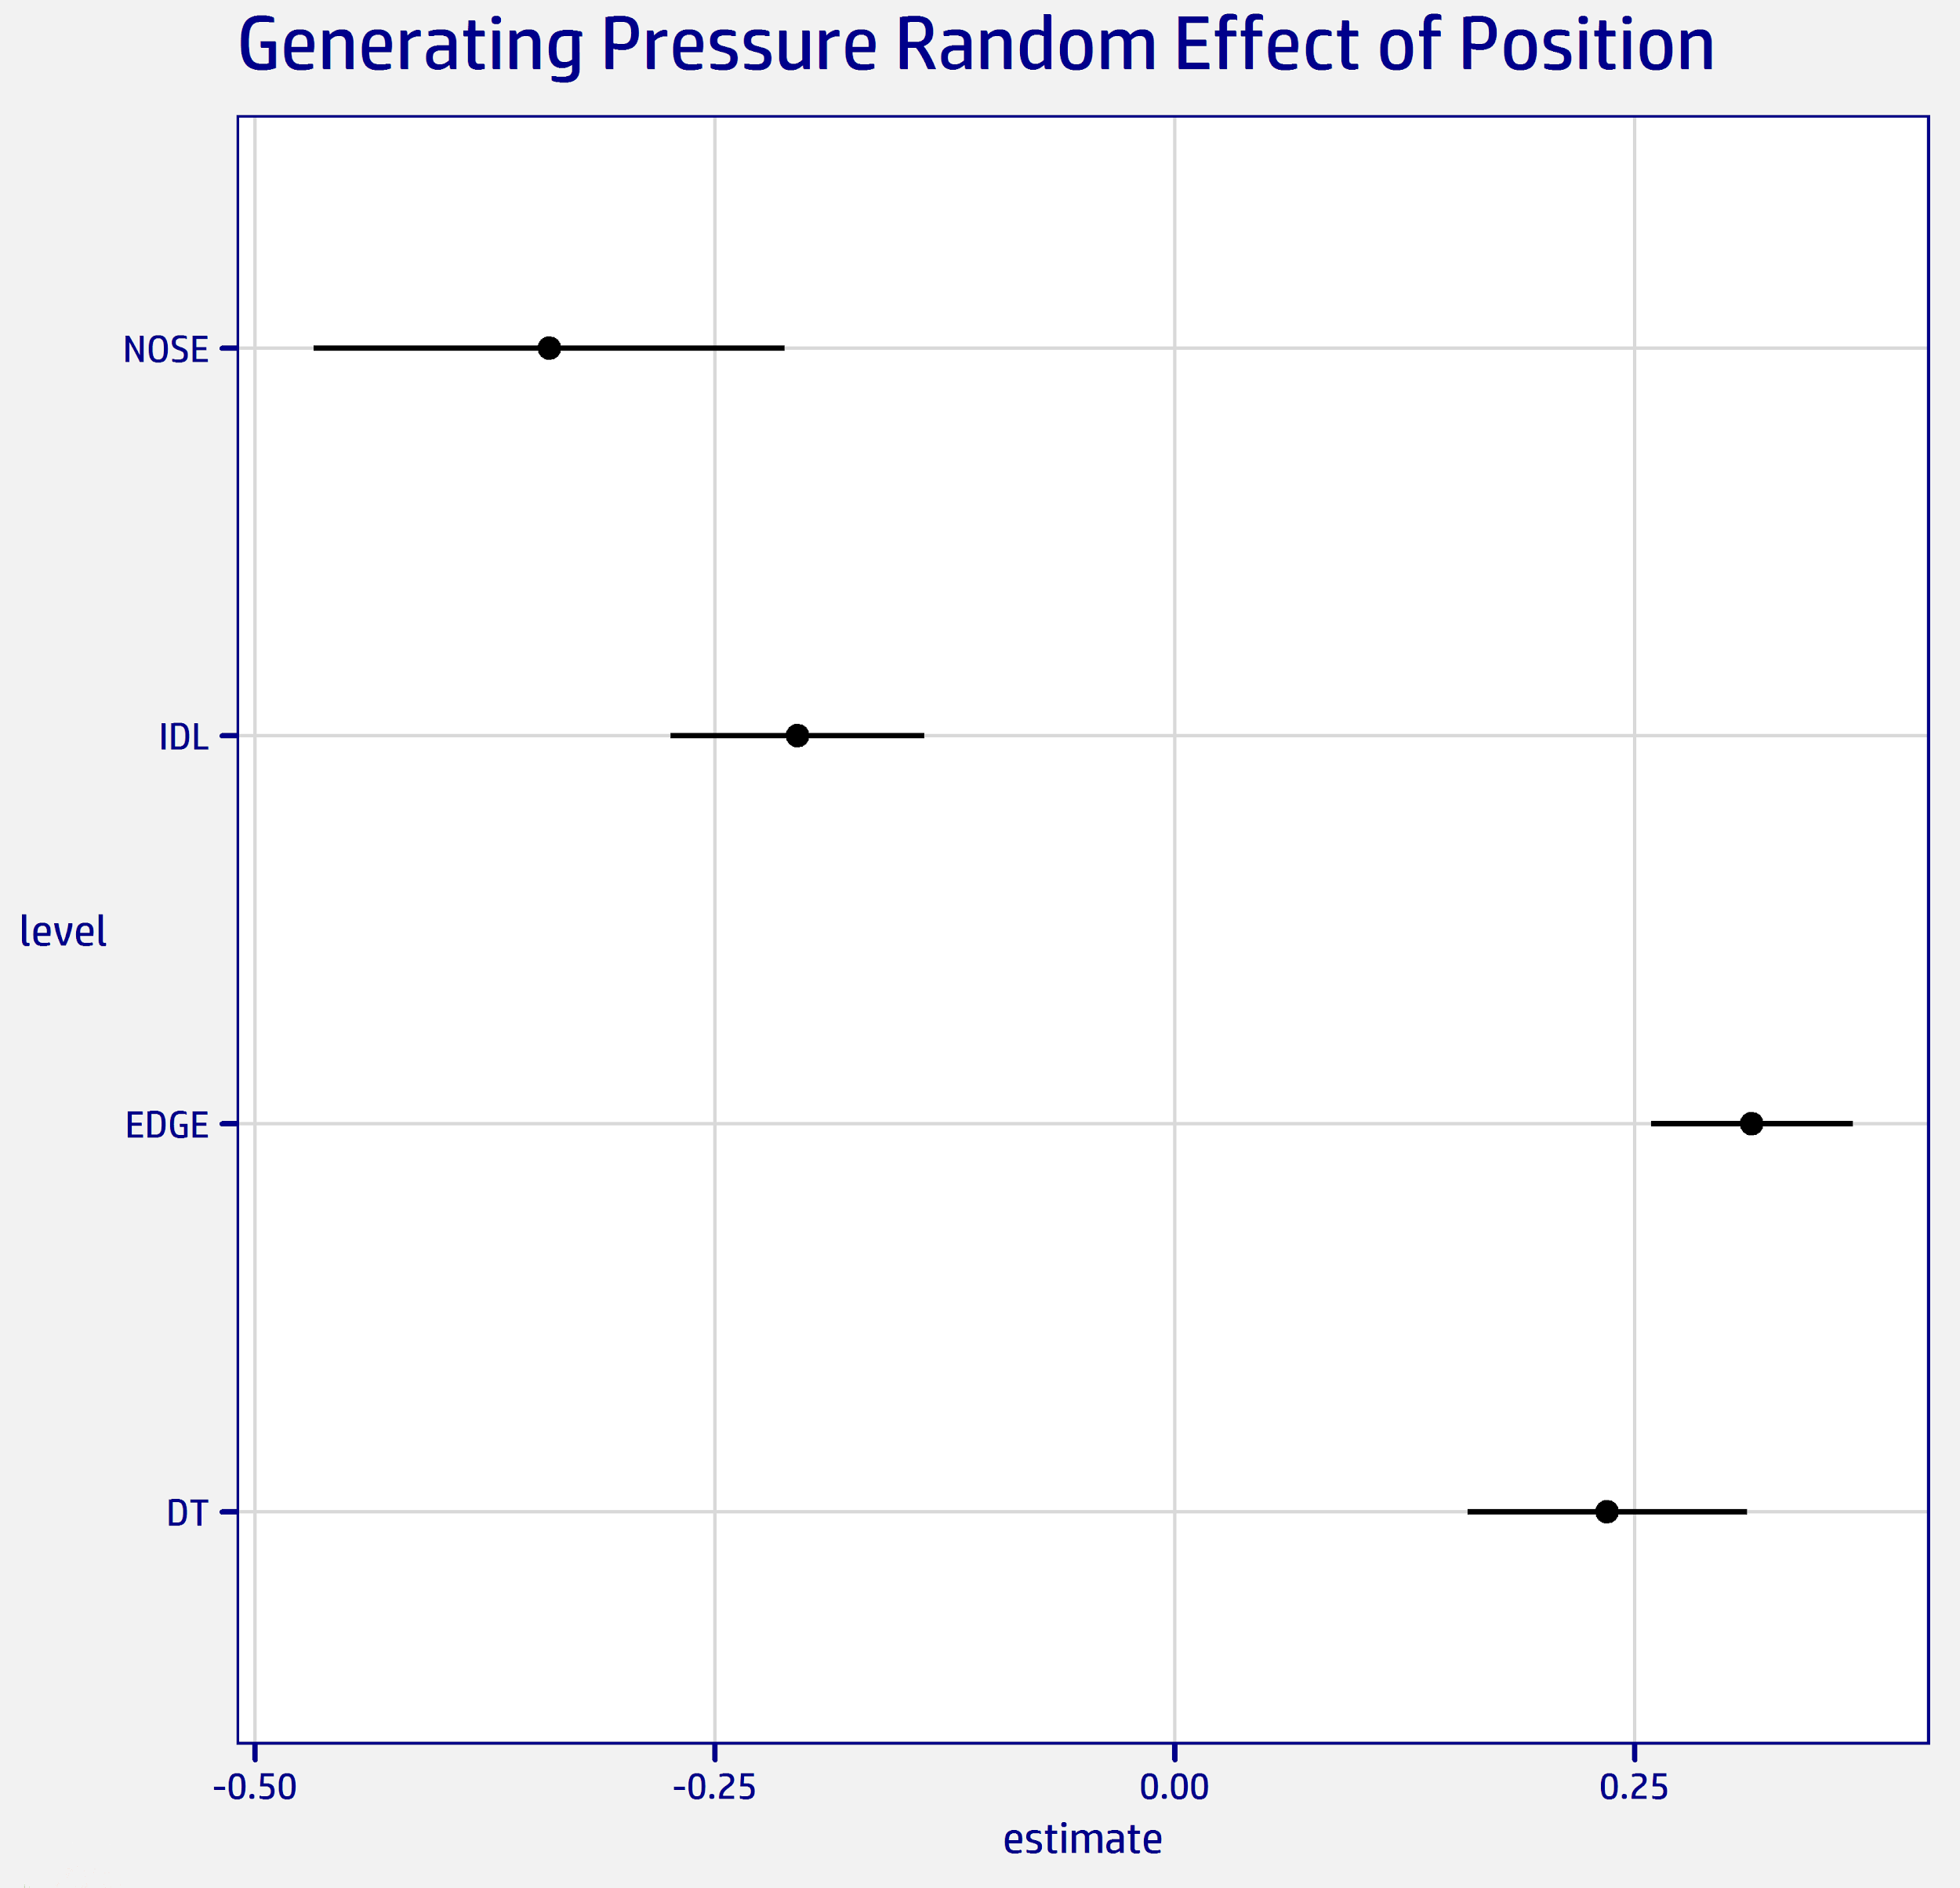
Random Effects of Position
We can see from the random intercepts from position that there is a significant difference between positions in the change in log-odds for generating a pressure.
EDGE and DT separate themselves from IDL and NOSE with the magnitude being higher than that of the Madden rating.

Slide 15
Question 1: Most Valuable D-Line Position?
Based on our analysis, we determined that the most valuable defensive line positions (per our definitions) are as follows:
EDGE
IDL
DT
NOSE

Slide 16
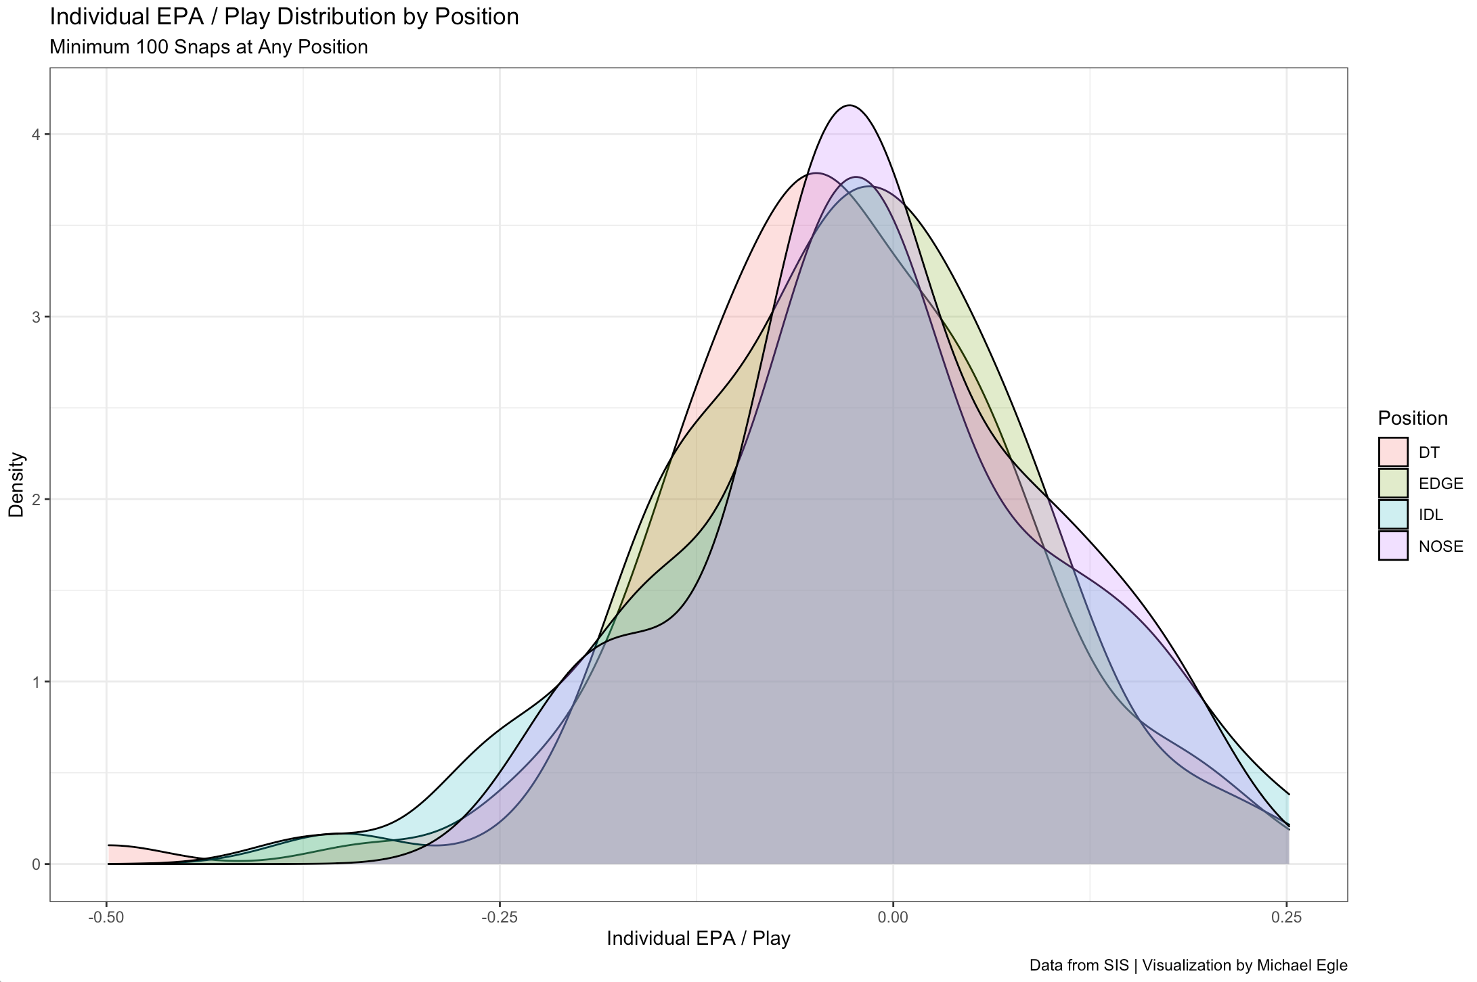
Question 2: Talent Distribution Among Positions?
In some contrast to the distribution of Madden ratings shown in our priors, we have a new distribution of EPA / Play for any player at any position they lined up at for at least 100 snaps.
Note: Unlike the earlier Madden ratings distribution, more talented players in terms of EPA / Play would appear further to the left.

Slide 17
Question 3: Different Situations?
From our two prior situations, only one ended up making a difference in how to view the positions. Short yardage situations didn’t change the ordering of positions, it only tightened up the range between them.
We saw a more substantial difference in generating pressure on the quarterback. Through the random effects from the logistic mixed model, we can see that there is a gap between EDGE/DT and IDL/Nose.
While EDGE remains the top position, we see that DT jumps IDL when we focus on generating pressure in the passing game.

Slide 18
Conclusions
As stated earlier, the most valuable position would be Edge Rushers. Likely because of their ability to disrupt the pass game much more significantly than any other position. Talent is distributed fairly evenly but not quite normally. As shown earlier, there are some instances where positions are more valuable than they would be overall, such as pressure generation. Overall, IDLs are more valuable than DTs but DTs are more valuable in generating pressure on an opponent’s QB.

Slide 19
Limitations and Future Analysis
One of the biggest challenges to overcome in this was the small sample size of the data. It’s difficult to draw groundbreaking conclusions from only half a season’s worth of data that only looks at defensive lineman. In the future, we believe it would be worth a look into whether our conclusions are the same in past seasons. Furthermore, it would be interesting to do similar analysis with NFL tracking data of all players.
Knowing how the linebackers, defensive backs, and offense are aligned could add a lot more context to how the defensive lineman performed.

